Slide 1

Machine learning and Clustering analysis to identify and validate peptide based diagnostic marker panel in meningioma
B.Tech Project
Jyotirmoy Roy
Under : Prof. Sanjeeva Srivastava

Slide 2
Work Progress in Machine learning Clustering analysis Aspect

Slide 3
Work Flow
SM Dataset
Find eigenvectors for each PCA
Use the top eigenvectors and find weights of each feature for these eigen vectors
Depending on this weights find top peptides(features)
Find the top common peptides
Train a Machine Learning Model with these features
DB Dataset
Find eigenvectors for each PCA
Use the top eigenvectors and find weights of each feature for these eigen vectors
Depending on this weights find top peptides(features)

Slide 4
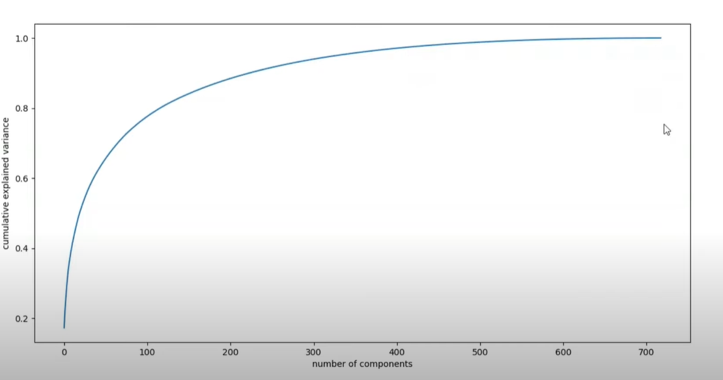
Variance Vs Number of Principal Components
It was seen 12 principal components were enough to retain 90% of the variance of the original feature set

Slide 5
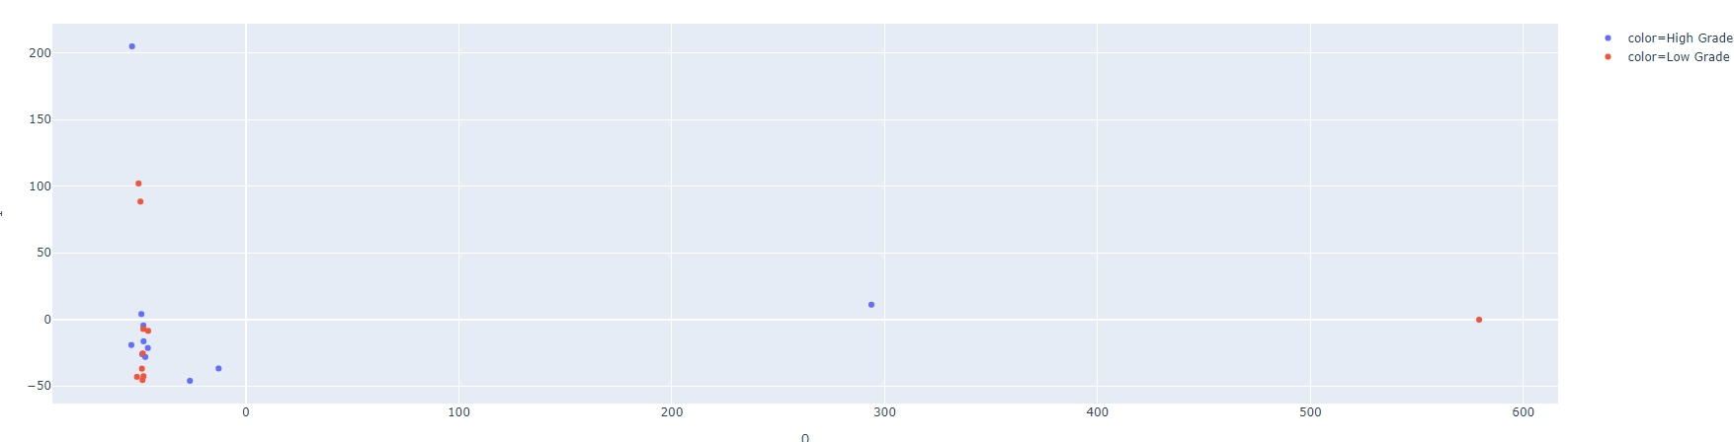
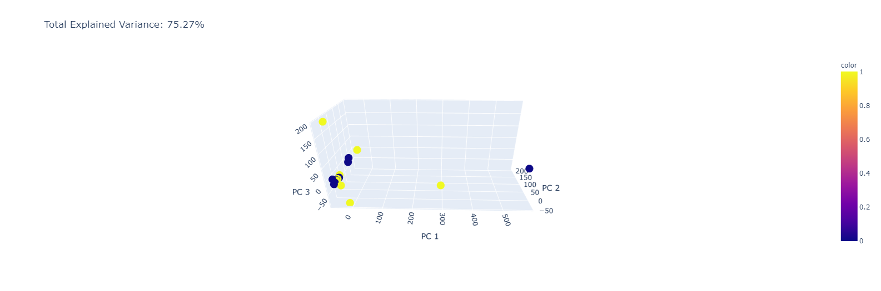
2D and 3D PCA plots for SM Database
As seen, the PC1 vs PC2 did not show any proper clusters
Even the 3D plot failed to show any significant clusters

Slide 6
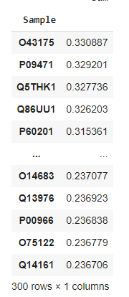
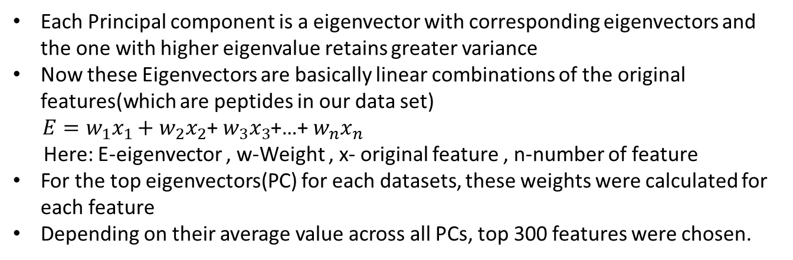
Eigen values and Eigenvectors for PCA
Each Principal component is a eigenvector with corresponding eigenvectors and the one with higher eigenvalue retains greater variance
Now these Eigenvectors are basically linear combinations of the original features(which are peptides in our data set)
$E=w_{1}x_{1}+w_{2}x_{2}$+ $w_{3}x_{3}$+…+ $w_{n}x_{n}$
Here: E-eigenvector , w-Weight , x- original feature , n-number of feature
For the top eigenvectors(PC) for each datasets, these weights were calculated for each feature
Depending on their average value across all PCs, top 300 features were chosen.

Slide 7
List of Common Peptides for SM and DB Database
 | Peptides
0 | P54652
1 | P26447
2 | Q96CN7
3 | Q9Y625
4 | P02652
5 | P02675
6 | Q13510
7 | P00747
8 | P39060
9 | Q14126
10 | Q9BWS9
11 | P05090
12 | P19827
13 | P19652
14 | P61626
15 | P02730
16 | P25311
17 | O15438
18 | P08697
19 | O95816
20 | O00592
21 | P02766
22 | P01861
23 | Q9UM54
24 | P35556
25 | P22105
26 | P25685
27 | Q15714
28 | P02753
29 | P02679
30 | P02750
31 | P08311
32 | A0A0B4J1X5
33 | O75884
34 | P00966
35 | P02671
36 | P17677
37 | Q96T23
38 | P12429
39 | P14923
4 common peptides in top 100 peptides for each set
17 common peptides in top 200 features for each set
40 common peptides in top 300 features for each set

Slide 8
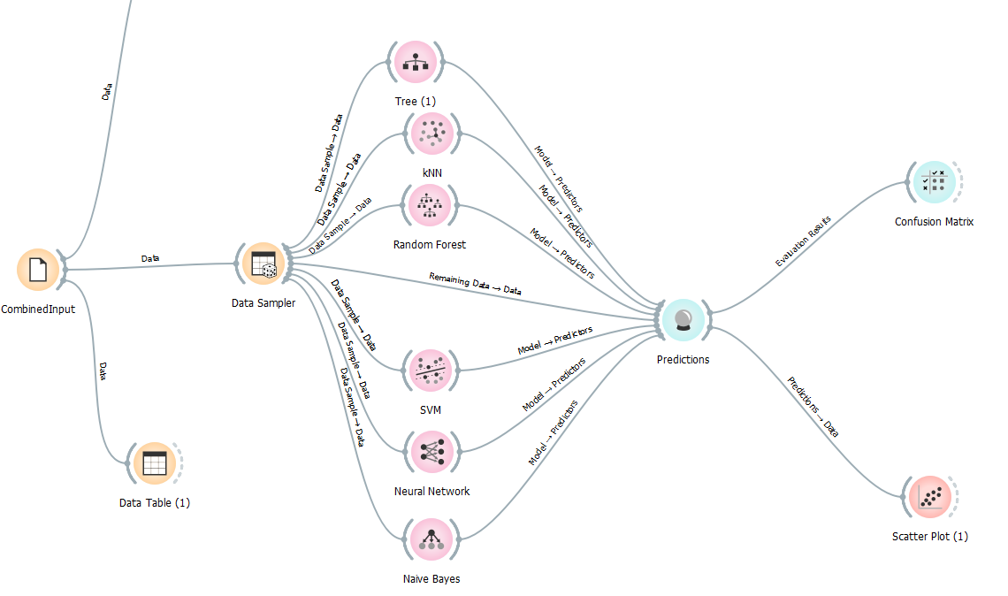
Training Machine Learning Model
The top 40 common peptides were taken as features.
The combined dataset of SM and DB was applied as an input to various machine learning models
70 percent of the data was taken as training set and rest as test

Slide 9
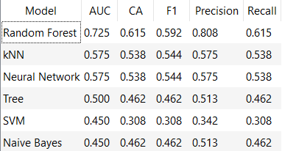
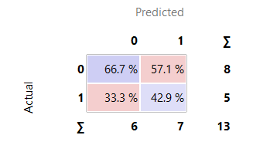
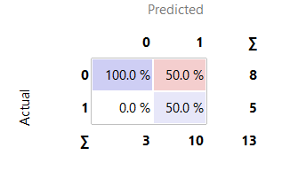
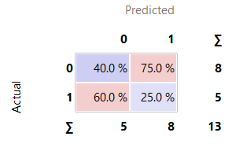
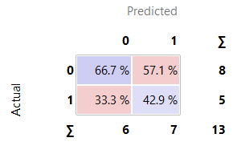
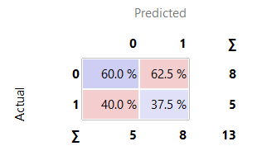
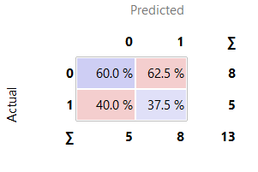
Training Machine Learning Model
kNN
Random Forest
SVM
kNN
Neural Network
Naïve Bayes
Trees

Slide 10
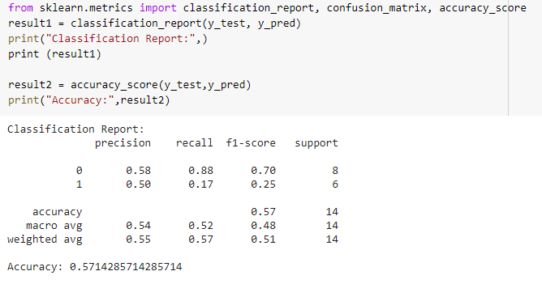
Random Forest Model In Python
The code for Random Forest was implemented
The features taken were : No of instances= 10 ; Depth =5
An accuracy of 57.5% was obtained for this dataset

Slide 11
Agendas for Next Week
Use the Random Forest algorithm to find out the weight it assigns to each original feature(peptide) from each dataset and see how many are common
Implement the other models on Python and see which one is giving the highest feature
Start the MS Stat analysis on Targeted Files for Meningioma
Work on the PTM workflow for Meningioma files

Slide 12
THANK YOU

